Slide 1
Previously on SIEM, SOAR, and XDR…

Slide 2

"I finally master Azure’s products, acronyms, and concepts! It was a breeze!“
François, 26 years old

Slide 3

"I agree with François!
Véronique, 31 years old

Slide 4
EDR CASB Security Posture
Endpoint
Detection
(And) response
Applies to:
MS Defender for Endpoint Plans 1 & 2
Microsoft 365 Defender

Slide 5
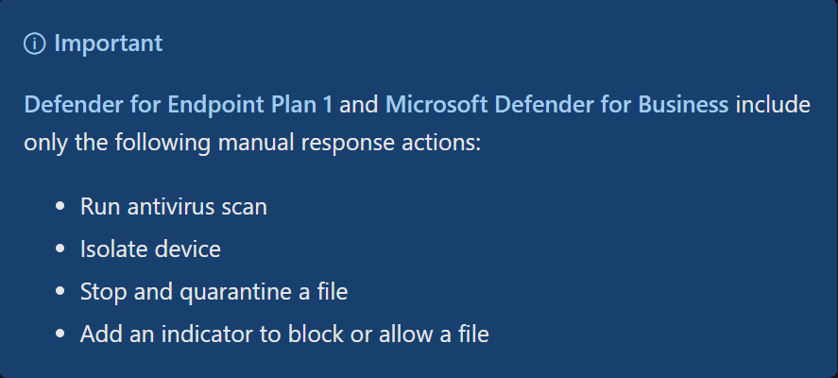

What does it do?
Think of EDR as an advanced AV. It secures ENDPOINTS.
Inspired by the "assume breach" mindset, it monitors and responds to advanced threats and malicious activities that traditional antivirus, or endpoint protection software might miss.
Endpoints: computers, servers, and mobile devices.

Slide 6
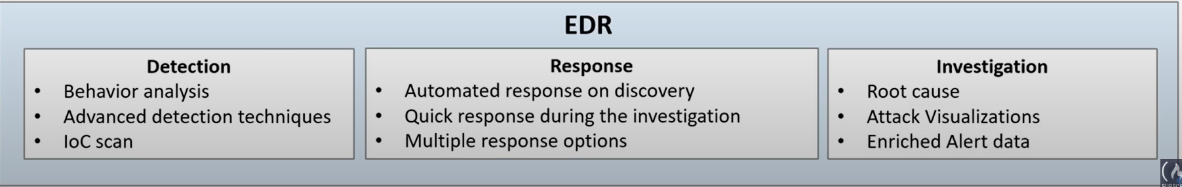
Key points
Information stored for 6 months.
Not intended to be an auditing or logging solution that records every operation or activity that happens on a given endpoint.
Entry/gate to the security perimeter.
EDPs are designed to detect APTs (Advanced Persistent Threat).
Like XDR (Extended Detection and Response).
XDR: Broad focus vs EDR: Endpoints.
Both can (should) be used.
Notes:
An Indicator of Compromise (IOC) is a set of data about an object or activity that indicates unauthorized access to the computer (compromise of data). For example, many unsuccessful attempts to sign into the system can constitute an Indicator of Compromise. The IOC Scan tasks allows finding Indicators of Compromise on the computer and take threat response measures.

Slide 7
Capabilities
Real-time Monitoring: Continuous monitoring of endpoint activities.
Behavioral Analysis: Establishing baseline behavior and identifying deviations.
Threat Detection: Using signatures, heuristics, ML, and threat intel for identification.
Incident Response: Investigating, containing, and remediating threats.
Forensics and Investigation: Reconstructing attack timeline and understanding tactics.
Automated Responses: Executing predefined actions for specific threats.
Integration with SIEM: Centralized monitoring and event correlation.

Slide 8
When to use it?
Advanced Threat Detection: Detecting sophisticated attacks in Azure.
Compliance Requirements: Meeting standards like HIPAA or GDPR.
Remote Workforce Security: Monitoring remote employee endpoints.
Zero-Day Exploit Mitigation: Detecting and responding to emerging threats.
Incident Response: Swift and targeted response to minimize damage.
Forensics and Post-Incident Analysis: Strengthening security postures.

